Slide 1

KLMUG14
-- MongoDB-TV & Document eCommerce --
Website: http://nosqlasia.org
FB: http://fb.com/groups/klmug
Twitter Handle: @klmug
--------------------------------------------------
GitHub: github.com/r1dotmy/klmugs
Notes:
1

Slide 2
REMINDERS
20 / 30 - Minute Presentations (use cases or technical demonstrations)
5 / 10 - Minute Lightening Talks
(knowledge share / shout-out)
BIG emphasis on Q&A
Notes:
2

Slide 3

Over 100 New Service Partners (2 from Malaysia)
http://mongodb.com/partners/services
MongoDB now valued at US$1.2 Billion
Notes:
3

Slide 4
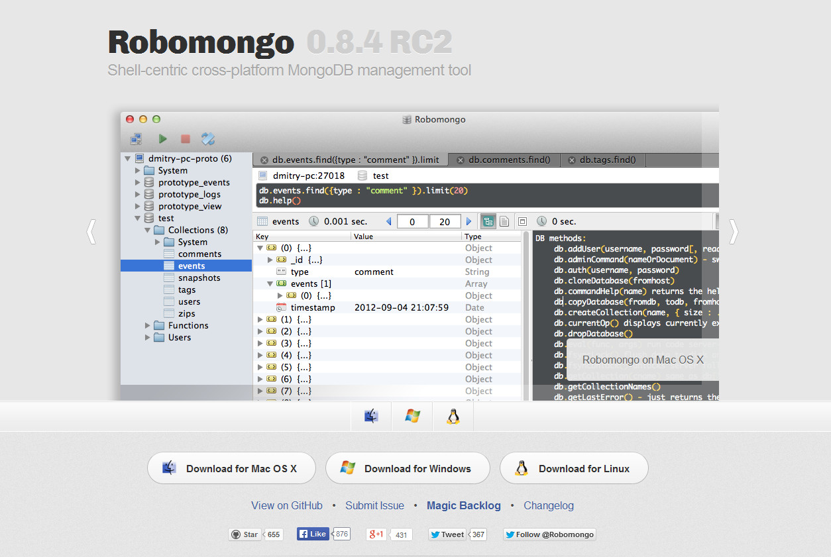
New Version of RoboMongo
Notes:
4

Slide 5

END OF THE LINE …?
Notes:
5

Slide 6

What would be best from the community …?
Notes:
6

Slide 7


MongoDB-TV and NodeJS
With Matias @mcascallares
Document eCommerce
With Tristan @parasquid
Notes:
7

Slide 8
DO WE HAVE ANY FIRST TIMERS …?
( break in case of emergency )

Slide 9




DATA AT THE APPLICATION LEVEL
“In 2012, NoSQL document stores like MongoDB received more than 70 percent of total
big-data tool demand. MongoDB from 10gen remains the top performer in this group.”
-- CNET
MongoDB Clients:
How MTV use mongoDB as a CMS - http://www.10gen.com/presentations/mongonyc-2011/how-mtv-networks-leverages-mongodb-for-cms
Notes:
9

Slide 10

EXCELLENT GEOLOCATION SUPPORT
Have you ever heard of Foursquare …?
Notes:
10

Slide 11
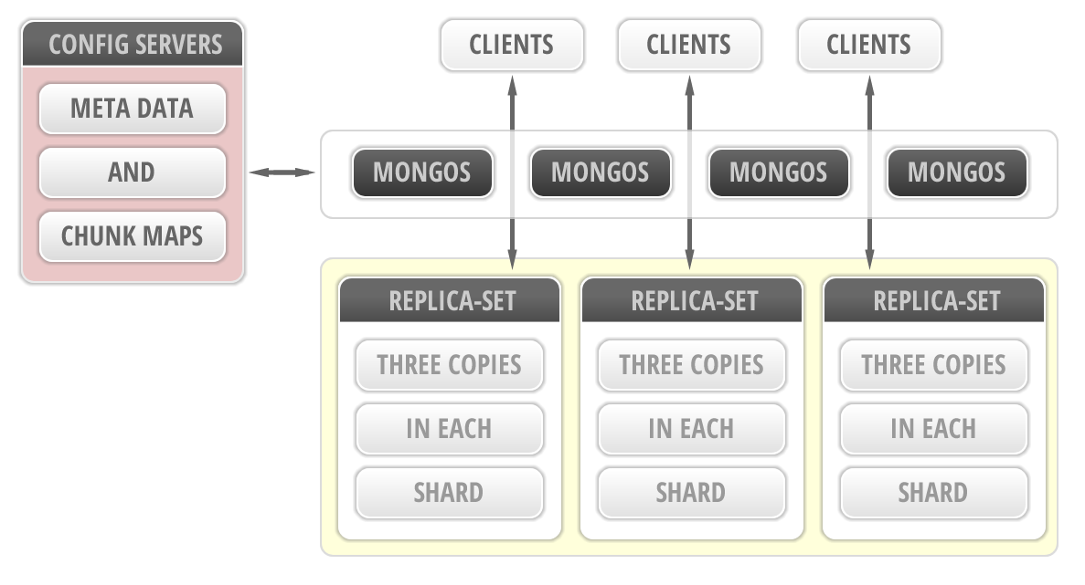
REPLICA-SETS AND SHARDING
Notes:
11

Slide 12

IT’S LIGHTENING FAST !!!
Some say 6,000 times faster than MySQL – http://lauli.ma/geo1
Notes:
12

Slide 13
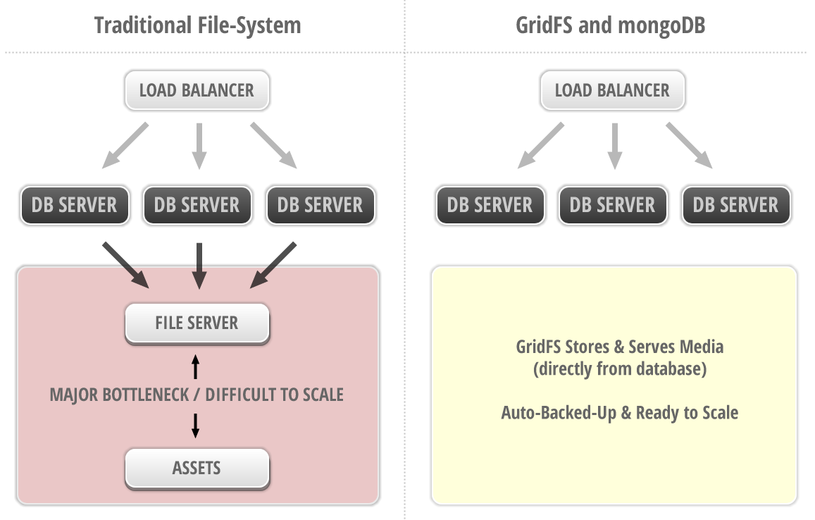
GRIDFS – MEDIA STORAGE & SERVING
Notes:
13

Slide 14

NO LANGUAGE BARRIERS
( ALSO KEEPS ALL LOGIC IN ONE PLACE )
Notes:
14

Slide 15
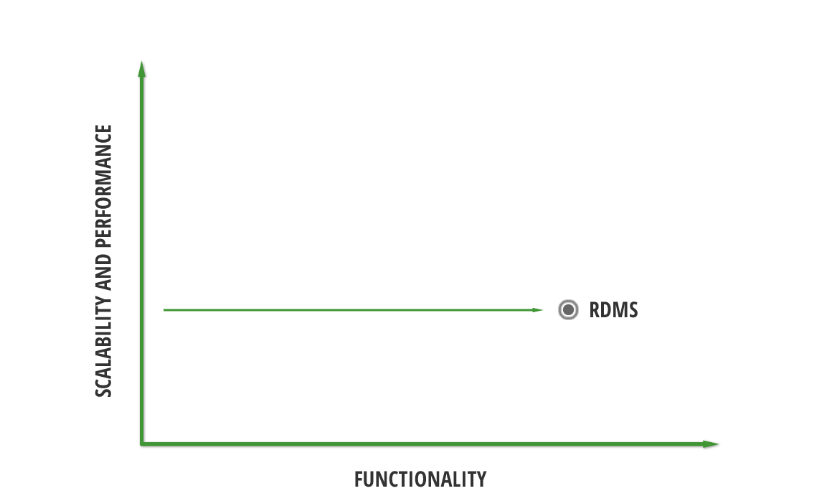
PERFORMANCE - VS - FUNCTIONALITY
Notes:
15

Slide 16
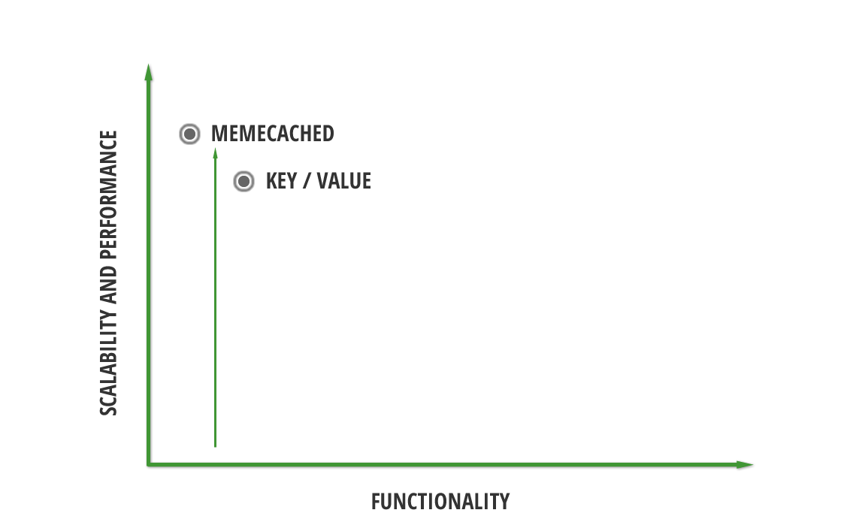
PERFORMANCE - VS - FUNCTIONALITY
Notes:
16

Slide 17
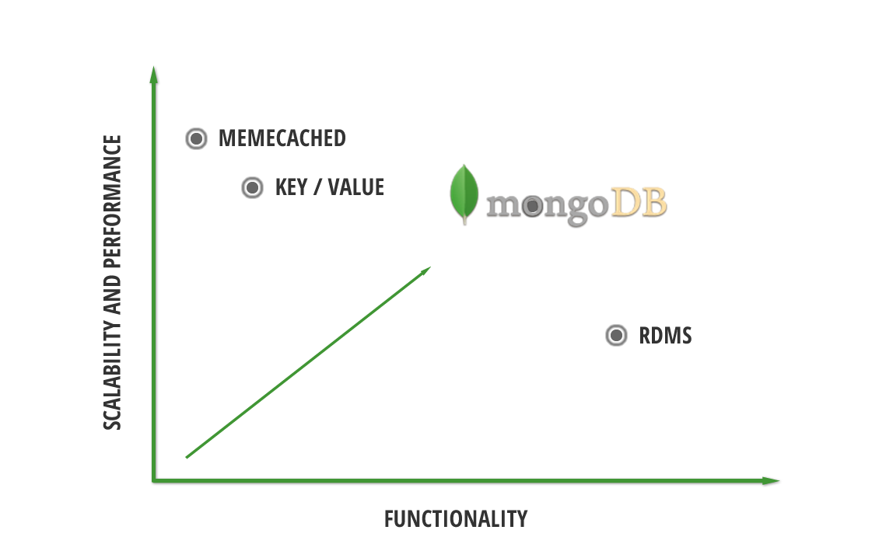
PERFORMANCE - VS - FUNCTIONALITY
Notes:
17

Slide 18

THERE IS NO SPOON !!!
( OR NEED TO LEAVE YOUR APP )
Notes:
18

